Slide 1
Timely Heuristic Evaluation
Atira, Marissa, Anton, Allison, Nisha, and Krupa

Slide 2
Overview
28 heuristic violations
Main categories violated and key specific issues
Recommendations
Notes:
Marissa

Slide 3
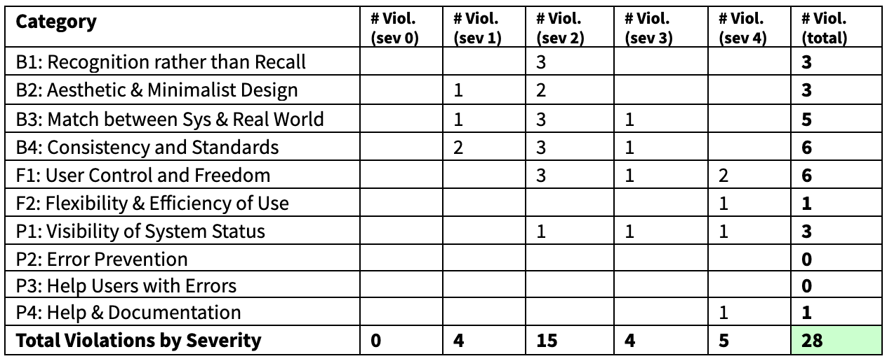
Overview cont.
Notes:
Marissa

Slide 4
Severity ratings
0 - don’t agree that this is a usability problem
1 - cosmetic problem: need not be fixed unless extra time available
2 - minor usability problem: fixing this is low priority
3 - major usability problem; important to fix so should be high priority
4 - usability catastrophe; imperative to fix before product can be released
Notes:
Marissa

Slide 5
User control & freedom
Notes:
Marissa

Slide 6
Definition
“Users often choose system functions by mistake and will need a clearly marked ‘emergency exit’ to leave the unwanted state without having to go through an extended dialogue. Support undo and redo.”
Notes:
Marissa

Slide 7
No clear method to skip adding classes
Notes:
Marissa

Slide 8
No way to manually enter class
Notes:
Allison

Slide 9
Can I go somewhere to see this meeting again?

Slide 10
Editing your response only takes you to edit final notes

Slide 11
Consistency & Standards
Notes:
Marissa

Slide 12
Definition
“Users should not have to wonder whether different words, situations, or actions mean the same thing. Follow platform conventions.”
Notes:
Marissa

Slide 13
Green for free and white for busy is confusing and inconsistent
Notes:
Marissa

Slide 14
Notes:
Marissa

Slide 15
Up and down arrows to move between pages is confusing

Slide 16
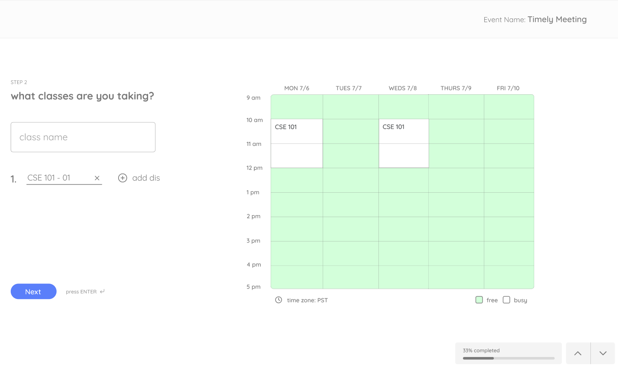
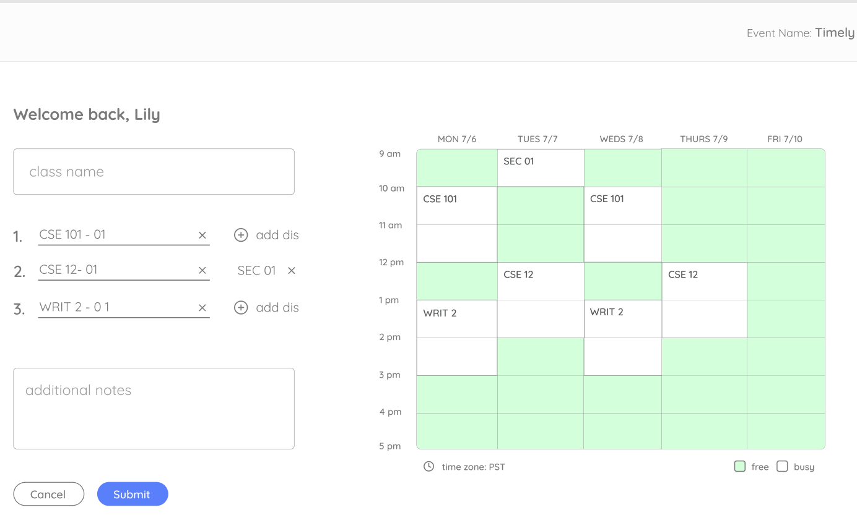
Arrows aren’t present across all the designs
Notes:
Anton

Slide 17
Match between System & World

Slide 18
Definition
“The system should speak the user's language, with words, phrases and concepts familiar to the user, rather than system-oriented terms. Follow real-world conventions, making information appear in a natural and logical order.”

Slide 19
What is “dis”?

Slide 20
Calendar?

Slide 21
Earliest time I’m free or earliest time for the meeting?
Time interval for what?
Notes:
Anton

Slide 22
Visibility of System Status

Slide 23
Definition
“The system should always keep users informed about what is going on, through appropriate feedback within reasonable time. Help the user know whether the ‘right thing’ happened.”

Slide 24
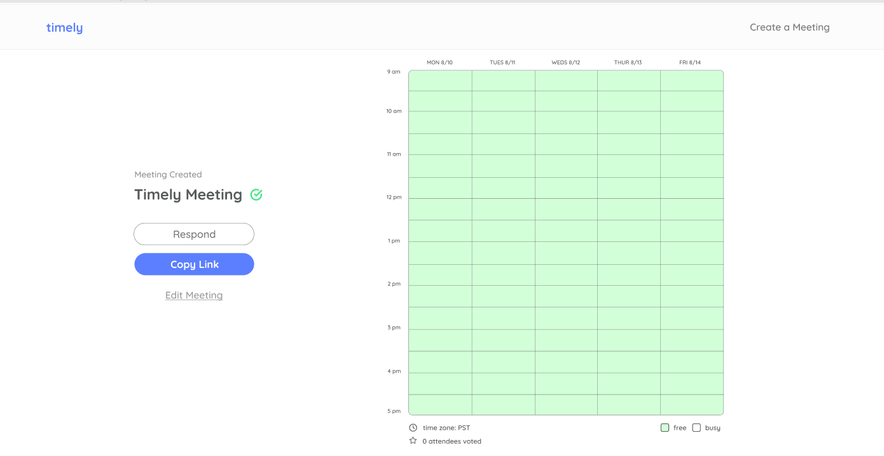
If users create a new meeting, there is no screen or pop-up telling them what the next steps are, what happened, and what to do.

Slide 25
If the user makes an error, there is no error message or error screen design
Notes:
Allison

Slide 26
Error Prevention & Help and Documentation

Slide 27
Definition
Error prevention: “Even better than good error messages is a careful design which prevents a problem from occurring in the first place. Either eliminate error-prone conditions or check for them and present users with a confirmation option before they commit to the action.”
Help and documentation: “Even though it is better if the system can be used without documentation, it may be necessary to provide help and documentation. Any such information should be easy to search, focused on the user's task, list concrete steps to be carried out, and not be too large.”

Slide 28
no way for the user to find an area to refer to instructions if they are confused on how to use the application or if they get lost.

Slide 29
Additional Recommendations

Slide 30
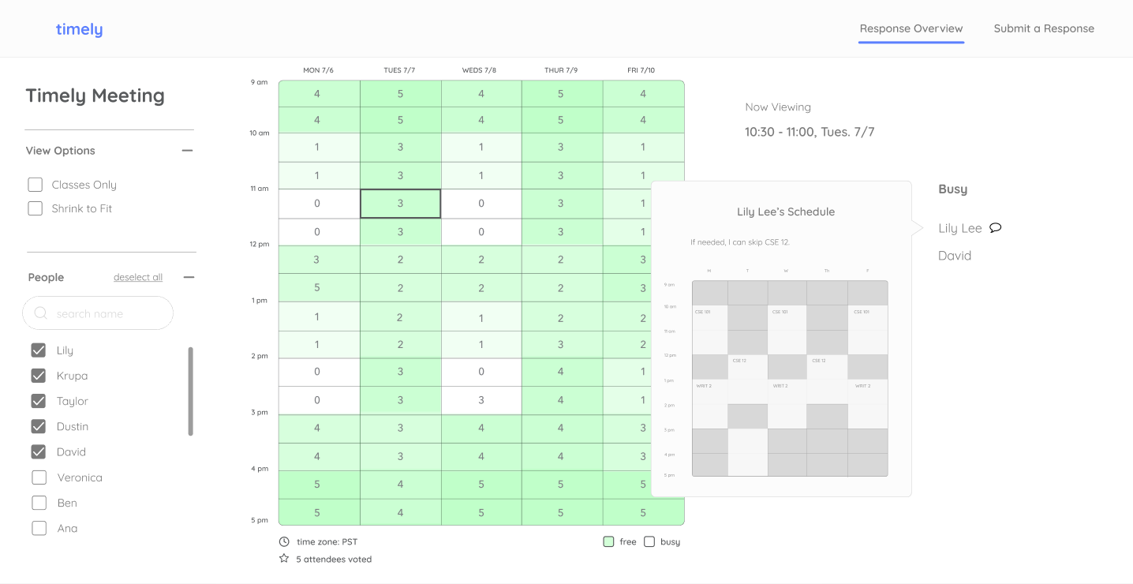
Time zones are unchangeable. It would be useful to change between time zones to see what the schedule looks like for other people in different countries/regions.

Slide 31
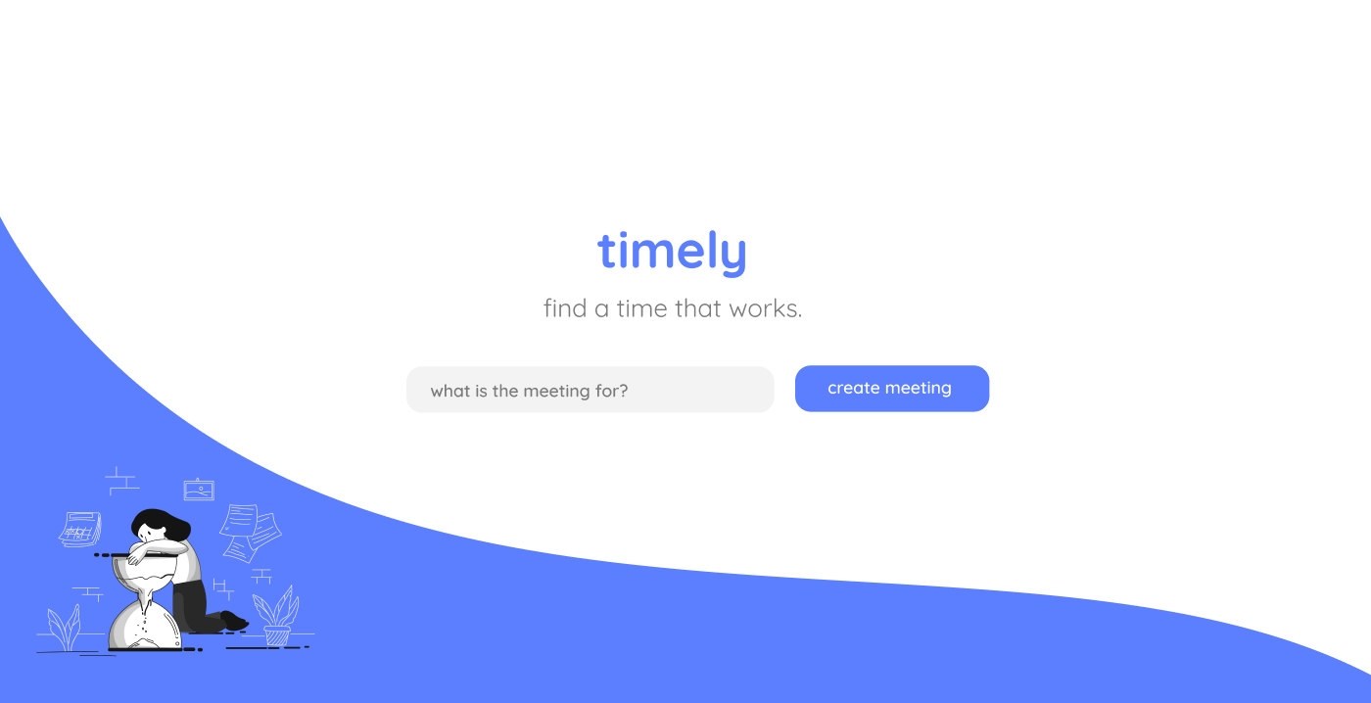
Users have no way to view all their created meetings easily.

Slide 32
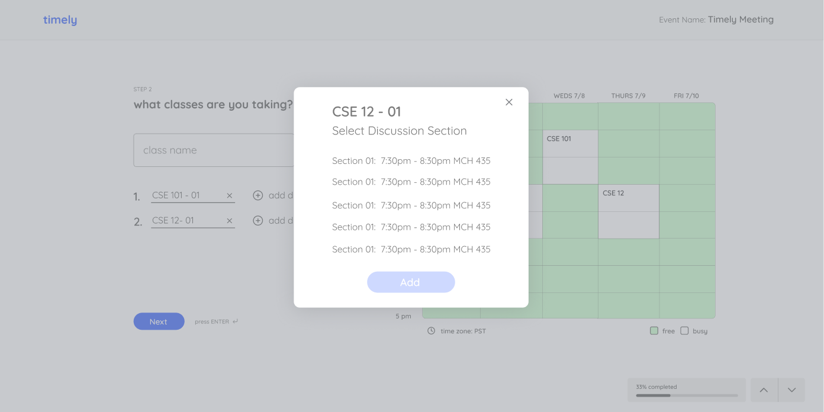
There is no way to add an updated/custom discussion section

Slide 33
Discussion

