Slide 1
Timely Usability Testing
Atira, Marissa, Anton, Allison, Nisha, and Krupa

Slide 2
Overview
6 usability tasks, 3 participants
Quantitative metrics + data
Severity ratings
Task observations, additional problems + solutions
Notes:
Atira

Slide 3
Tasks
Create a meeting.
Edit a meeting.
Share a meeting with group members.
Respond to a meeting.
Edit your meeting response.
Access your user notes.
Notes:
Atira

Slide 4
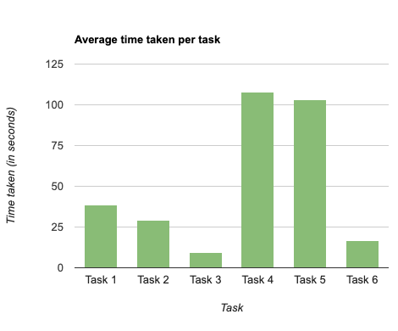
Time taken per task
Notes:
Atira

Slide 5
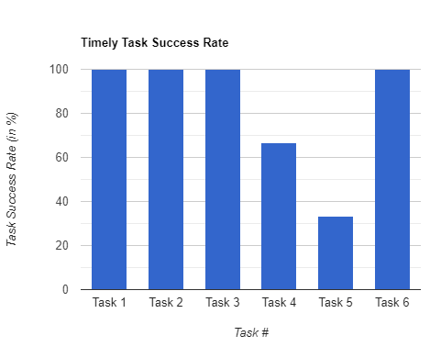
Task success rate
Notes:
Atira

Slide 6
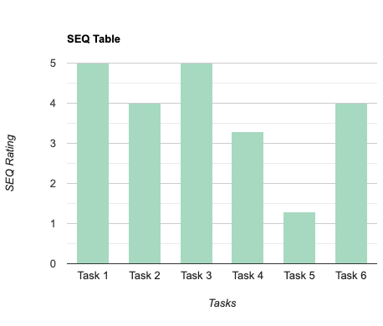
Average SEQ score
Notes:
Atira

Slide 7
Severity ratings
0 - don’t agree that this is a usability problem
1 - cosmetic problem: need not be fixed unless extra time available
2 - minor usability problem: fixing this is low priority
3 - major usability problem; important to fix so should be high priority
4 - usability catastrophe; imperative to fix before product can be released
Notes:
Atira

Slide 8
Task Observations, Problems,
+ Solutions
Notes:
Anton

Slide 9
Task 1:
Create a Meeting
Notes:
Marissa

Slide 10
Observations
Task #1: Create a Meeting
3/3 participants navigated through and created a meeting fairly quickly (average task time of 38 seconds)
Participant 3 commented that the layout reminded them of another scheduling app Calendly
Notes:
Marissa

Slide 11
Task 2:
Edit a meeting
Notes:
Marissa

Slide 12
Observations
Task #2: Edit a meeting
⅔ participants didn’t realize they could select multiple days and did so accidentally
1 participant edited their meeting from the homepage and bypassed the Edit meeting link entirely, suggesting it is not salient enough
Notes:
Marissa

Slide 13
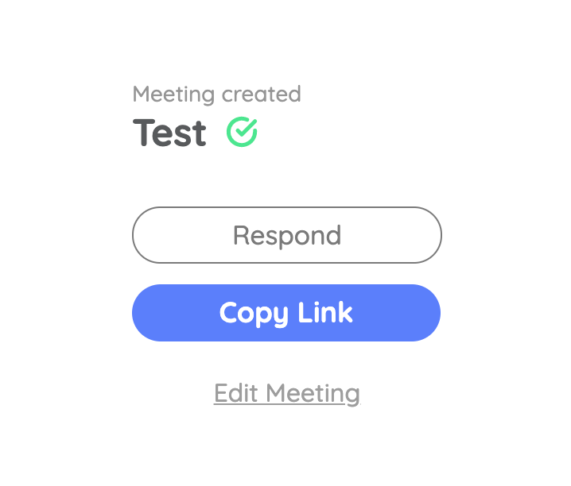
Problem #1
Task #2: Edit a meeting
The edit meeting link is not very clear, causing a user to navigate to the home page in order to edit a meeting
Severity: 1
Solution: Use larger font, make it an interactable button rather than a hyperlink
Notes:
Marissa

Slide 14
Problem #2
Task #2: Edit a meeting
The option to select multiple days when creating a meeting is unclear to users.
Severity: 3
Solution: Change “What dates are possibilities?” to “What date(s) are possibilities?”
Notes:
Marissa

Slide 15
Problem #3
Task #2: Edit a meeting
When going back to edit the meeting, the old meeting dates are not saved, forcing users to have to remember what they were.
Severity: 3
Solution: Make the previously selected dates visible on the calendar
Notes:
Marissa

Slide 16
Task 3: Sharing a Meeting with Group Members
Notes:
Krupa

Slide 17
Quantitative Data
Task #3: Sharing a Meeting with Group Members
Task Success Rate — 100%
Average Task Time — 9.63 seconds
Average SEQ score — 5
There were no observations made. All participants were able to complete the task with ease.
Notes:
Krupa

Slide 18
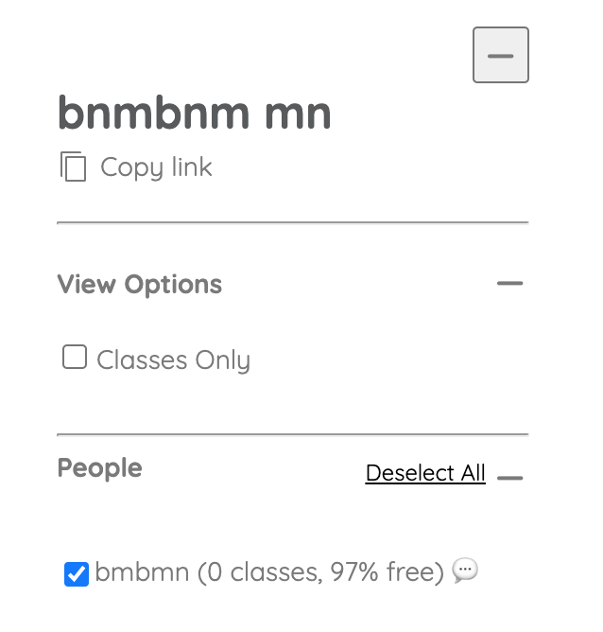
Problem
Task #3: Sharing a Meeting with Group Members
Not obvious or salient enough, confused users might ignore this.
Participants did not have a problem with this (and this was changed after the usability testing) but we found that the copy link option was difficult to locate in the review responses page.
Severity: 2
Solution: Make the copy link button more salient. Possibly put it into a rectangular button, make it a different color, or place it in an empty area away from text in order to highlight that it’s there.
Notes:
Krupa

Slide 19
Task 4:
Responding to a meeting
Notes:
allison

Slide 20
Observations
Task #4: Responding to a meeting.
All three participants were initially confused with the class search function
1/3 participants were confused what to do if they didn’t want to input any classes
1/3 participants were confused about the schedule display (expected a normal weekday)
2/3 participants successfully understood and completed the task in the end

Slide 21
Problem #1
Task #4: Responding to a meeting
Users had trouble understanding the class search function
Severity: 3
Solution: Add a guiding title such as “Add any classes you have, or press Next,” or add subtext below the current title that says “if you aren’t taking any, press Next.”

Slide 22
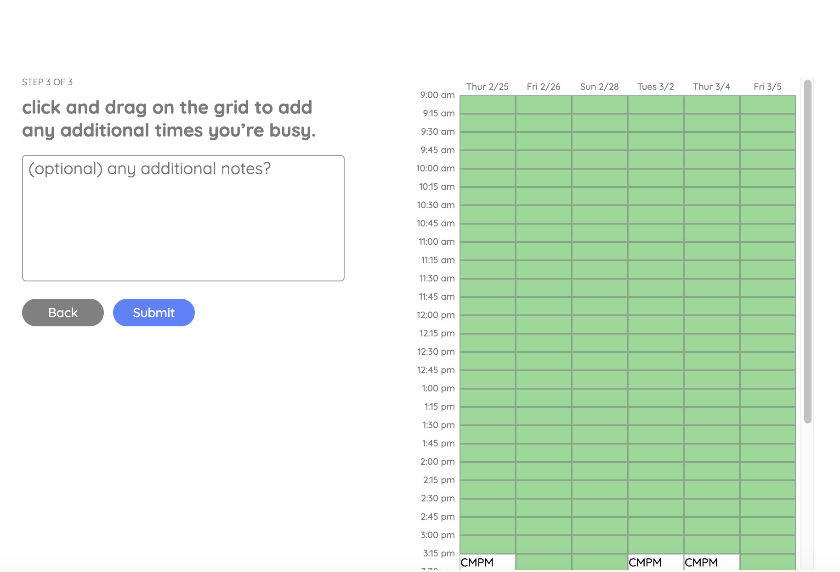
Problem #2
Task #4: Responding to a meeting
Add title here
User expected the schedule shown to be a regular weekday instead of the chosen meeting dates
Severity: 2
Solution: Add a title to the schedule such as “[Meeting]’s schedule” or “[Meeting]’s availabilities.”
User misunderstood that this schedule is supposed to be a regular week
Notes:
allison

Slide 23
Task 5:
Editing Your Response From The Review Page
Notes:
Nisha

Slide 24
Observations
Task #5: Editing Your Response From The Review Page
⅓ participants didn’t know where to go (submit a response) initially
⅓ participants don’t want to submit “another” response
⅓ participants try to go back to initial meeting created
⅔ participants go to the review responses page before the submit page
⅓ participants went all the way back to the main page by clicking timely icon
2/3 participants were confused by where to edit previous responses
⅔ gave up on the task
Notes:
Nisha

Slide 25
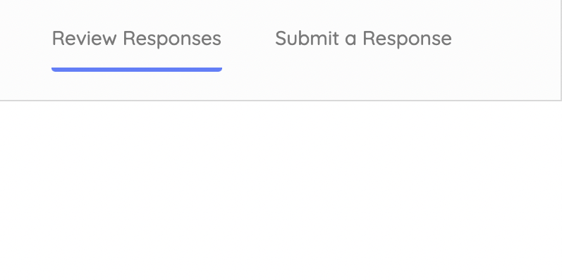
Problem
Task #5: Editing Your Response From The Review Page
Users do not initially know where to go in order to submit a response.
Severity: 4
Solution: Make the ‘ submit responses’ button more prominent on the page. Change the phrasing to ‘Edit’ rather than ‘submit’.
Notes:
Nisha

Slide 26
Problem
Task #5: Editing Your Response From The Review Page
Users didn’t know where to edit previous responses and ultimately gave up on completing the task.
Severity: 4
Solution: Have a guide or some indication to where users can be directed.
Notes:
Nisha

Slide 27
Task 6: Accessing User’s Notes
Notes:
Atira

Slide 28
Observations
Task #6: Accessing User’s Notes
⅓ Participants don’t understand that they’re already on the review responses page in the beginning
⅓ Participants click on pop-up bubble for notes
Notes:
Atira

Slide 29
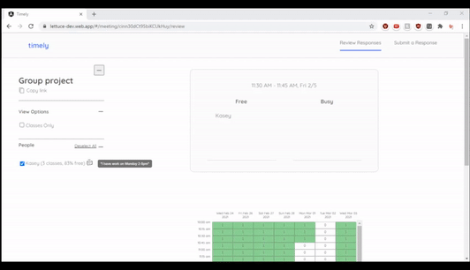
Problem #1
Task #6: Accessing User’s Notes
Users initially did not know they were on the correct page to access their notes
Severity: 1
Solution: Clearly identify that the user can access notes by placing visible text as guidance (ex: View Notes)
Notes:
Atira

Slide 30
Discussion
Notes:
Anton

